Slide 1
RSPC PowerPoint Template
(You can delete these default slides)

Slide 2
Tips - Styling
For daytime / daylight, try to use:
A white or light background
Dark text
Don’t make text or images too small!

Slide 3
Tips - Styling
For evening / darkness, try to use:
A black or dark background
White text
Don’t make text or images too small!

Slide 4
Tips - Slides
Don’t use animations on slide elements.
Don’t include videos on the slides, provide these separately.
If possible, provide a script or outline of your talk with annotations of where you want the slides to be.

Slide 5
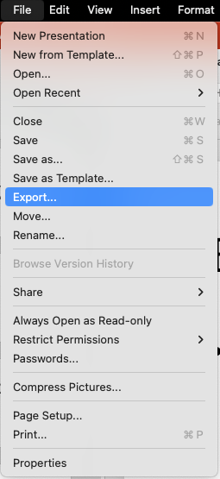
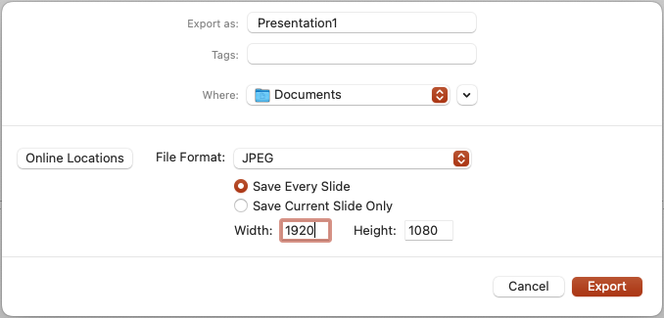
Exporting
Please export your slides as JPEG images.
Size should be 1920 width and 1080 height.

